Slide 1
4th MEETING PGC-D3 Small Scale LNG
14-15 May 2014
Osaka, Japan

Slide 2
Welcome and PGC-D3 Agenda
Wednesday 14th May
08:30-10:10 | Plenary
10:10-10:30 | Break
10:30-11:00 | Group Session | Intro (Wouter Meiring): Looking back and looking forward, LNG World Report, abstracts Welcome to new group members
11:00-12:00 | Group Session | Feedback from subgroups x2
12:00-12:30 | Presentation | Logistics in the Small LNG Value Chain (G. Fiandaca)
12:30-14:00 | Lunch | Hartwell Hall (22nd floor)
14:00-15:00 | Group Session | Feedback from subgroups x2
15:00-15:45 | Group Session | Getting ready for next phase: working towards report structure, new groups
16:00-18:00 | Subgroups | Working in subgroups
Thursday 15th May
08:30-08:50 | Group Session | Health check/feedback from subgroups
08:50-10:00 | Subgroups | Working in subgroups
10:15-12:30 | Subgroups | Working in subgroups
12:30-14:00 | Lunch | Hartwell Hall (22nd floor)
14:00-15.15 | Subgroups | Working in subgroups
15:15-16:15 | Group Session | Subgroups to report back/ Conclusions and Way Forward
16:30-18:00 | Plenary

Slide 3
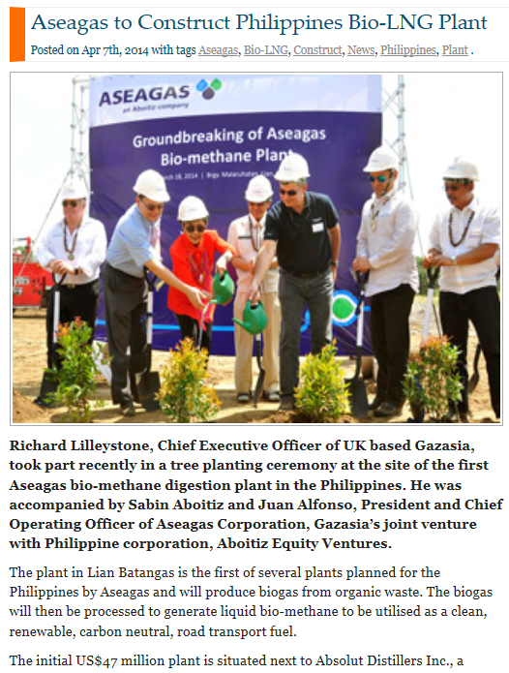
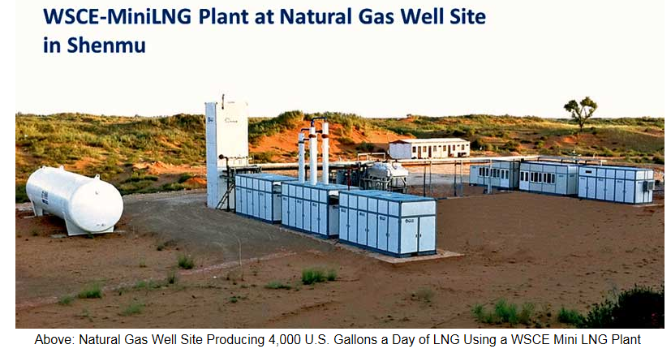
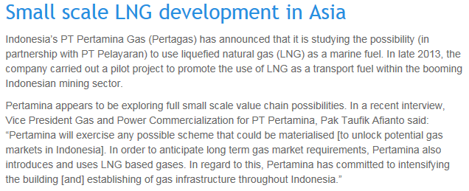
Business developments in Small-Scale LNG

Slide 4
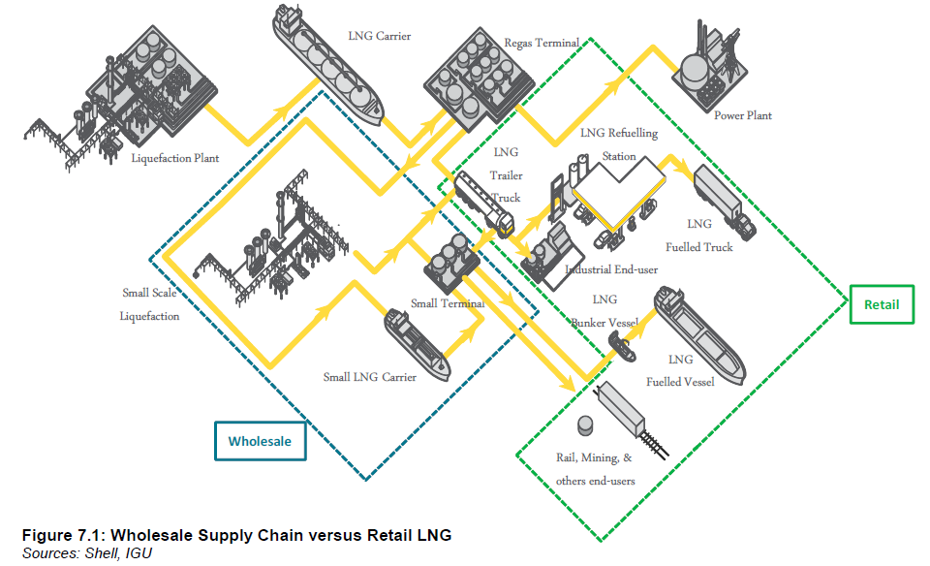
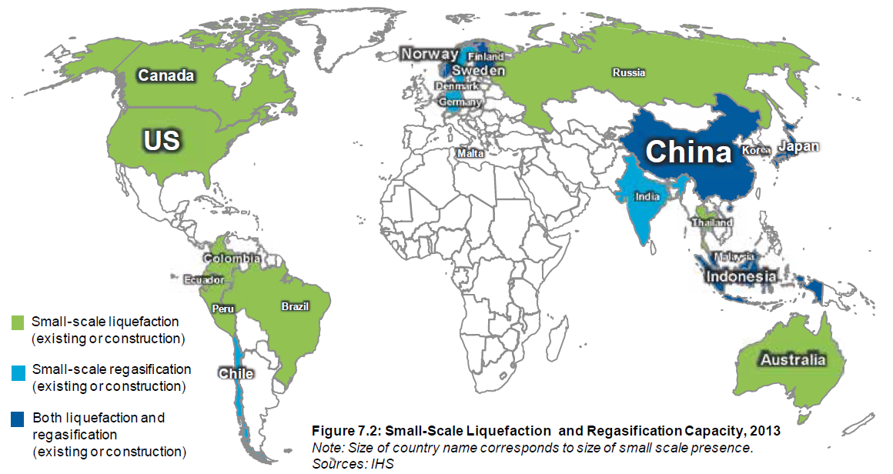
Feedback from past quarter
Each subgroup successfully submitted a regional overview
Very active cooperation among subgroup leaders for the submission of the special report on Small-Scale LNG for the LNG World Report

Slide 5
Check point- where are we?
Japan
13th-16th May
Malaysia
22nd-25th September
Initial drafts ready (send to presidium 2 weeks before coordination meeting)
Qatar
28th -31st January
Final drafts ready (send to presidium before Jan 2015). Finalise Report and Layout
Work on draft report
Call for abstracts

Slide 6
Invitation for abstracts
Please submit your abstract for the WGC in Paris
Submission can be made via this website
Important Dates:
Call for abstracts closes: 1 September 2014
Notification for authors: 28 November 2014
WGCPARIS2015 Conference: 1 to 5 June 2015
Criteria for selection shall be based upon:
Conformity to the purpose of the respective topic
Relevance and degree of benefit to the gas industry
Originality
Content and presentation quality
Relevance to the conference theme "Growing together towards a friendly planet“
and/or to one or several of the 4 pillars of the strategic theme.

Slide 7
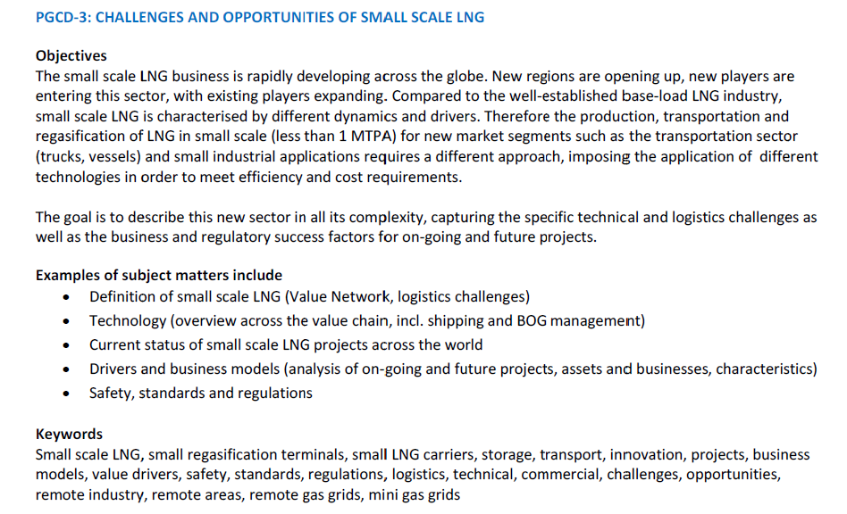
WGCPARIS2015 – PGC-D3 session

Slide 8
PGC D3 – List of Members
1 | Lead | Wouter | Meiring | Wouter.Meiring@shell.com | Holland | Shell | Manager LNG Front End Development
2 | Vice Chair | Ieda | Gomes | ieda@energixstrategy.com | UK | Energix strategies | Managing Director
3 | Secretary | Giovanna | Fiandaca | giovanna.fiandaca@shell.com | Netherlands | Shell | LNG Process Engineer
4 |  | Jorge | Gómez de la Fuente | jgomezdlf@repsol.com | Spain | Repsol | Manager LNG Business Development Projects
5 |  | Thilo | Schiewe | thilo.schiewe@linde-le.com | Germany | Linde | VP, Mgr. BU LNG & NG, Linde Eng. (Hangzhou)
6 |  | Marcel | Tijhuis | m.g.m.tijhuis@gasunie.nl | NL | Gasunie | Business Development
7 |  | Christophe | Adotti | christophe.adotti@total.com | France | TOTAL | LNG project engineer
8 |  | Yukiko | Nishizaka | y-nishi@tokyo-gas.co.jp | Japan | Tokyo Gas | Manager, Planning Section
9 |  | Azam | Aziz Al-Mannai | AAAlmannai@qatargas.com.qa | Qatar | QatarGas | Head of LNG Marketing- West of Suez
10 |  | Nuno | Moreira | nmoreira@dourogas.pt | Portugal | Dourogas | Administration Board
11 |  | Marcio | Bastos Demori | Marcio.demori@petrobras.com.br | Brasil | Petrobras | LNG Trading Manager
12 |  | Sreekanth | Vemula | sreve@dongenergy.dk | Denmark | Dong Energy | Senior Business Developer
13 |  | Miroslav | Lekic | miroslav.lekic@srbijagas.com | Serbia | JP Srbijagas | Director of Investments
14 |  | Dubravko | Prostenik | dubravko.prostenik@plinacro.hr | Croatia | Plinacro | Engineer
15 |  | Hervé | Jourde | herve.jourde@elengy.com | France | Elengy | LNG Projects, Technical Department
16 |  | Fernando | Impuesto | fimpuesto@enagas.es | Spain | Enagas | Director of Commercial Operations & TPA
17 |  | Feikje | Wittermans | feikje.wittermans@vopak.com | Netherlands | VOPAK LNG | Business Development Manager
18 |  | Juan | Sanchos Suils | jsanchos@repsol.com | Spain | Repsol
19 |  | Menno | Bax | Menno.bax@shell.com | Netherlands | Shell | LNG Innovation Manager
20 |  | Andreas | Gemballa | andreas.gemballa@eon-ruhrgas.com | Germany | Eon Ruhrgas
21 |  | Hadsaitong | Panumart | panumart.h@pttplc.com | Thailand | PTT | Mgr. Commercial and Sales Division, Gas BU
22 |  | Sopanowong | Dhosapol | dhosapol.s@pttlng.com | Thailand | PTT | Operation Supervisor
23 |  | GSP | Singh | singhgsp@indianoil.in | India | Indian Oil | Chief Manager LNG
24 |  | Mohit | Jain | mohit@indianoil.in | India | Indian Oil | Deputy Manager (LNG)
25 |  | Anna | Purgina | a.purgina@gazpromlpg.ru | Russia | Gazprom
26 |  | Andrew | Alderson | Andrew.Alderson@shell.com | UK | Shell Stasco | Trading and Shipping Project Manager
27 |  | Sanggyu | Lee | lsg@kogas.or.kr | Korea | Kogas | Chief Research Engineer
28 |  | Vaclav | Chrz | vaclav.chrz@chartindustries.com | Czech Republic | Chart | Director Technology Development
29 |  | Izana | Mohd | Izanam@petronas.com.my | Malaysia | Petronas | Market Research
30 |  | Abdulla | Alneama | aaalneama@rasgas.com.qa | Qatar | RasGas | Short Term Sales
31 |  | Samad | Rahimi | Rahimi_s@nigc.ir | Iran | NIGC | Managing Director BB2GT Co.
32 |  | Khun Warat | Patanaungkul | warat.p@pttplc.com | Thailand | PTT | Area Manager
33 |  | Kanthida | Montralak | Kanthida.d@pttplc.com | Thailand | PTT | Analyst
34 |  | Arrigo | Vienna | arrigo.vienna@eni.com | Italy | ENI
35 |  | Angel | Roho Bianco | Arojo@enagas.es | Spain | Enagas | Commercial Account Manager
36 |  | Nikolay | Sudarev | nikolay.sudarev@gazprom-germania.de | Germany | Gazprom | Senior Project Manager

Slide 9
List of Participants – Osaka Meeting
1 | Lead | Wouter | Meiring | Holland | Shell | Manager LNG Front End Development
2 | Vice Chair | Ieda | Gomes | UK | Energix strategies | Managing Director
3 | Secretary | Giovanna | Fiandaca | Netherlands | Shell | LNG Process Engineer
4 |  | Jorge | Gómez de la Fuente | Spain | Repsol | Manager of LNG Business Development Projects
5 |  | Thilo | Schiewe | Germany | Linde | VP, Mgr. BU LNG & NG, Linde Eng.
6 |  | Christophe | Adotti | France | TOTAL | LNG project engineer
7 |  | Yukiko | Nishizaka | Japan | Tokyo Gas | Manager, Planning Section
8 |  | Azam | Aziz Al-Mannai | Qatar | Qatargas | Head of LNG Marketing- West of Suez
9 |  | Feikje | Wittermans | Netherlands | VOPAK LNG | Business Development manager
10 |  | Sopanowong | Dhosapol | Thailand | PTT Public Company Limited | Operation Supervisor
11 |  | Kanthida | Montralak | Thailand | PTT Public Company Limited | Analyst
12 |  | GSP | Singh | India | Indian Oil | Chief Manager LNG
13 |  | Arrigo | Vienna | Italy | ENI
14 |  | Mohit | Jain | India | Indian Oil | Deputy Manager (LNG)
15 |  | Abdulla | Alneama | Qatar | Rasgas | Short Term Sales Marketing & Shipping Group
16 |  | Nicolay | Sudarev | Germany | Gazprom
17 |  | Samad | Rahimi | Iran | National Iranian Gas Company | Managing Director BB2GT Co.
18 |  | Angel | Roho Bianco | Spain | Enagas | Commercial Account Manager

Slide 10
Welcome to New Members
Samad Rahimi
Abdulla al Neame
Nikolay Sudarev
Kanthida Montralak
Getting to Know Each Other
Name, current job…
Involvement in LNG/Small Scale LNG
Previous involvement with IGU
Reason for joining
Expectations

Slide 11
PGC-D3 Small Scale LNG
Barcelona Outcome
Discussion on report template
Ways of Working
Subgroups will produce draft sections of the report (1st version available at year end)
Meeting in Japan
First Report Draft Available
Review and further develop the chapters – build the overview beyond the regions
Regional Subgroups shared progress on data gathering and observed trends
More frequent communication and use of the PGC_D3 collaboration workspace on the IGU site
Discussions on logistics, BOG management, safety and regulations
Discussions on Small Scale LNG archetypes

Slide 12
Welcome and PGC-D3 Agenda
Wednesday 14th May
08:30-10:10 | Plenary
10:10-10:30 | Break
10:30-11:00 | Group Session | Intro (Wouter Meiring): Looking back and looking forward, LNG World Report, abstracts Welcome to new group members
11:00-12:00 | Group Session | Feedback from subgroups x2
12:00-12:30 | Presentation | Logistics in the Small LNG Value Chain (G. Fiandaca)
12:30-14:00 | Lunch | Hartwell Hall (22nd floor)
14:00-15:00 | Group Session | Feedback from subgroups x2
15:00-15:45 | Group Session | Getting ready for next phase: working towards report structure, new groups
16:00-18:00 | Subgroups | Working in subgroups
Thursday 15th May
08:30-08:50 | Group Session | Health check/feedback from subgroups
08:50-10:00 | Subgroups | Working in subgroups
10:15-12:30 | Subgroups | Working in subgroups
12:30-14:00 | Lunch | Hartwell Hall (22nd floor)
14:00-15.15 | Subgroups | Working in subgroups
15:15-16:15 | Group Session | Subgroups to report back/ Conclusions and Way Forward
16:30-18:00 | Plenary

Slide 13
Report Back - Subgroups (30’ each)
Technology,
Definition
Christophe
Europe incl. Russia + Africa
Feikje (for Marcel)

Slide 14
Presentation
Small Scale LNG Logistics – Giovanna

Slide 15
Updated Afternoon Program
Feedback from Thilo and Jorge (15’ each)
New subgroups compositions (20’)
Break into working in subgroups (we have one extra room available)
Back into group session at 5pm (logistics presentation and other)

Slide 16
Report Back - Subgroups (30’ each)
Asia - Pacific
Thilo
Jorge (for Marcio)
Americas

Slide 17
Welcome and PGC-D3 Agenda
Wednesday 14th May
08:30-10:10 | Plenary
10:10-10:30 | Break
10:30-11:00 | Group Session | Intro (Wouter Meiring): Looking back and looking forward, LNG World Report, abstracts Welcome to new group members
11:00-12:00 | Group Session | Feedback from subgroups x2
12:00-12:30 | Presentation | Logistics in the Small LNG Value Chain (G. Fiandaca)
12:30-14:00 | Lunch | Hartwell Hall (22nd floor)
14:00-15:00 | Group Session | Feedback from subgroups x2
15:00-15:45 | Group Session | Getting ready for next phase: working towards report structure, new groups
16:00-18:00 | Subgroups | Working in subgroups
Thursday 15th May
08:30-08:50 | Group Session | Health check/feedback from subgroups
08:50-10:00 | Subgroups | Working in subgroups
10:15-12:30 | Subgroups | Working in subgroups
12:30-14:00 | Lunch | Hartwell Hall (22nd floor)
14:00-15.15 | Subgroups | Working in subgroups
15:15-16:15 | Group Session | Subgroups to report back/ Conclusions and Way Forward
16:30-18:00 | Plenary

Slide 18
NEXT PHASE
FROM
REGIONAL SUBGROUPS
TO
CHAPTERS SUBGROUPS

Slide 19
New Groups based on Report Structure
Executive Summary (objectives and overview)
Definition (Value Network, boundaries, overview)
Drivers and Business Models (intro followed by regional analysis of ongoing and future projects, assets and businesses, characteristics, )
Players (across the value chain, categories, differences across the regions)
Technology (overview across the value chain, logistics, incl. shipping)
Safety, standards and regulations
Outlook and Conclusions (challenges and way forward)
Appendices (Reference &info sources list, Technology Matrix, Players list, data from regions,…)

Slide 20
Working Sub-groups – Starting Point
Drivers/Business Models
Americas
GSP Singh, Jorge, Kanthida, Izana, Azam, Abdulla,
Europe incl. Russia + Africa
Feikje, Nicolay, Angel, Ieda
Asia - Pacific
Arrigo, Thilo, GSP Singh, Mohit Jain, Dhosapol, Samad
Technology,
Definition
Christophe, Sanggyu, Giovanna, Thilo, Wouter
Players
Safety and Regulations
Tech. & Definition
Notes:
Are you not listed in your regional subgroup?
Do you like the proposal?

Slide 21
New Subgroups Composition
Definition
Technology
Christophe, Sanggyu, Giovanna, Thilo, Wouter
Drivers and Business Models
GSP Singh, Jorge, Kanthida, Izana, Azam, Abdulla
Players
Feikje, Nicolay, Angel, Ieda
Safety, Standards and Regulations
Arrigo, Thilo, GSP Singh, Mohit Jain, Dhosapol, Samad

Slide 22
GUIDELINES – WORKING IN NEW SUBGROUP
Outline of the chapter – submit word document
Appoint a subgroup leader
Collect the data coming from the regions
Assess whether further data gathering will be necessary
Agree work distribution
…Start Writing!!
Report Out (1 slide with summary of above points to be shared Thursday before end of meeting)

Slide 23
Welcome and PGC-D3 Agenda: Day 2
Thursday 15th May
08:00-09:00 | Group Session | Logistics/Deliverables of the day/Ways of working
09:00 – 11:00 | Subgroups | Working in subgroups: start word document with headers of the sections and individual responsibility
11:00-12:30 | Group Session | Working in subgroups: Work on your sections
12:30-13:30 | Lunch | Hartwell Hall (22nd floor)
13:30-15.30 | Subgroups | Working in subgroups: check progress on chapters
15:30-16:15 | Group Session | Check progress on report based on subgroups feedback/ Conclusions and Way Forward
16:30-18:00 | Plenary

Slide 24
Way Forward
Milestones
31st July: Subgroups to have first draft
31st August: Subgroups to submit revised draft
Ways of Working
Monthly meeting within the subgroups and among subgroup leaders
Individual contributions to be submitted to the subgroup leaders timely
Meeting in KL: Compile and Review full report draft
Subgroups leaders to upload latest version of their chapters on collaboration area
Provide template for each chapters

Slide 25
Collaboration Area
Username: MPGC_D
Password: LNG is good
You can login now as Member PGC D and on the web site, please go to: Web site IGU: www.IGU.org
About IGU - IGU Organisation - Committees 12-15 - Programme committees - PGC D – Collaboration – PGC D study group 3 small scale LNG
All the material shared in the PGCD3 meetings, templates and presentations will be uploaded in the collaboration area

Slide 26
BACK UP

Slide 27
Collaboration Area
Username: MPGC_D
Password: LNG is good
You can login now as Member PGC D and on the web site, please go to: Web site IGU: www.IGU.org
About IGU - IGU Organisation - Committees 12-15 - Programme committees - PGC D – Collaboration – PGC D study group 3 small scale LNG
All the material shared in the PGCD3 meetings, templates and presentations will be uploaded in the collaboration area

