Slide 1
4th MEETING PGC-D3
Small Scale LNG
14-15 October 2013
Osaka, Japan

Slide 2
Report Structure
Executive Summary (objectives and overview)
Definition (Value Network, boundaries, overview)
Drivers and Business Model (intro followed by regional analysis of ongoing and future projects, assets and businesses, characteristics, )
Players (across the value chain, categories, differences across the regions)
Technology (overview across the value chain, logistics, incl. shipping)
Safety, standards and regulations
Outlook and Conclusions (challenges and way forward)
Appendices (Reference &info sources list, Technology Matrix, Players list, data from regions,…)

Slide 3
New Subgroups Composition
Definition
Technology
Christophe, Sanggyu, Giovanna, Thilo, Wouter
Drivers and Business Models
GSP Singh, Jorge, Kanthida, Izana, Azam, Abdulla
Players
Marcel, Feikje, Nicolay, Angel, Ieda
Safety, Standards and Regulations
Arrigo, Thilo, GSP Singh, Mohit Jain, Dhosapol, Samad

Slide 4
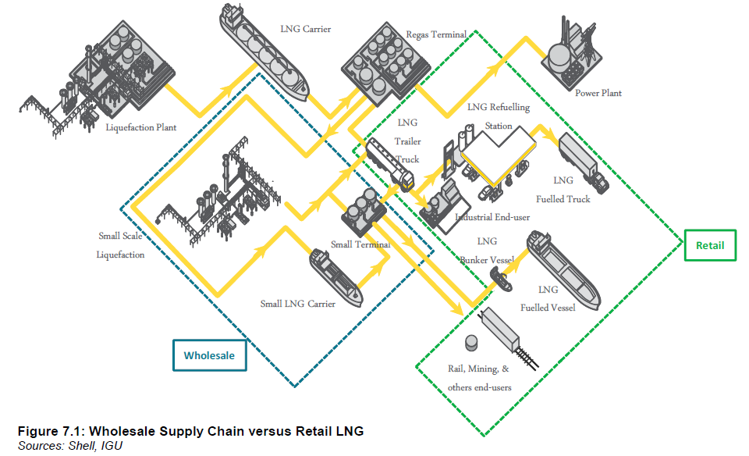
Definition
1. Value Network - Giovanna
  Conventional
  Small Scale Whole Sale
  Small Scale Retail
Small Scale Whole Sale - Christophe
Boundaries on volumes, capacities, relations between the elements
  Production
  Transport
  Breakbulk
  Regas

Slide 5
Drivers and Business Model
Drivers for production project – Abdulla
  Policy : Government regulations, taxes
  Economics (Diversification, Gas monetization , Capex/ Opex)
  Environmental
Drivers for consumption project : Azam
  Policy : Government regulations, taxes
  Economics (Diversification, Gas monetization , Capex/ Opex)
  Environmental
Business model for production project : Jorge, Izana
Business model for consumption project: Kanthida, GSP
Conclusions: GSP

Slide 6
Players
Overview of the value chain
Description of the players and their role in the value chain
Interaction of the players in the value chain

Slide 7
Technology
Production
  Layout – Giovanna (building blocks, simplification, modularisation)
  Treatment - Thilo
  Liquefaction - Sanggyu (Giovanna)
  Main Equipment (incl. manufacturers) - Giovanna
  Utilities - Thilo
Shipping – Giovanna/Andrew
  Characteristics of small LNG carriers (volumes, pressurised storage, cost, speed, loading rates, manning, compatibility)
  Status of small LNG carrier fleet (availability, shipyard constraints, trends, shipyards)
Regasification terminal – Christophe/ Sanggyu
Storage - Christophe
BOG management - Wouter
Logistics - Giovanna
Outlook (e.g. floating, future options)

Slide 8
Safety, Standards and Regulations
1. Standards
  Project development
  Design
  Operations
  Training
  Regulations
    Reference is only to Safety and Environmental regulation.
    Regulations are country/region-specific. Examples from:
    China (Thilo)
    India (GSP)
    Thailand (Dhosapol)
    USA (Ted William) [to be contacted]
    France (Chris)
    Italy & The Netherlands (Arrigo)
    Spain (Enagas) [to be contacted]
2. Conclusion and recommendations
Target: to develop and enforce regulations that can be uniformly adopted in the world.
Encourage for instance ISO standards development

Slide 9
Way Forward
Milestones
31st July: Subgroups to have first draft
31st August: Subgroups to submit revised draft
Ways of Working
Monthly meeting within the subgroups and among subgroup leaders
Individual contributions to be submitted to the subgroup leaders timely
Meeting in KL: Compile and Review full report draft
Subgroups leaders to upload latest version of their chapters on collaboration area

